Slide 1
UAV Outback Challenge
Stephen Dade

Slide 2
The OBC
The Outback UAV Challenge (OBC) requires teams to design, build and operate a UAV capable of finding a missing bushwalker and drop a bottle of water to them
$50,000 first place prize
116 teams (2014) from around the world
Several Deliverables along the way
Very few teams make it to the end

Slide 3
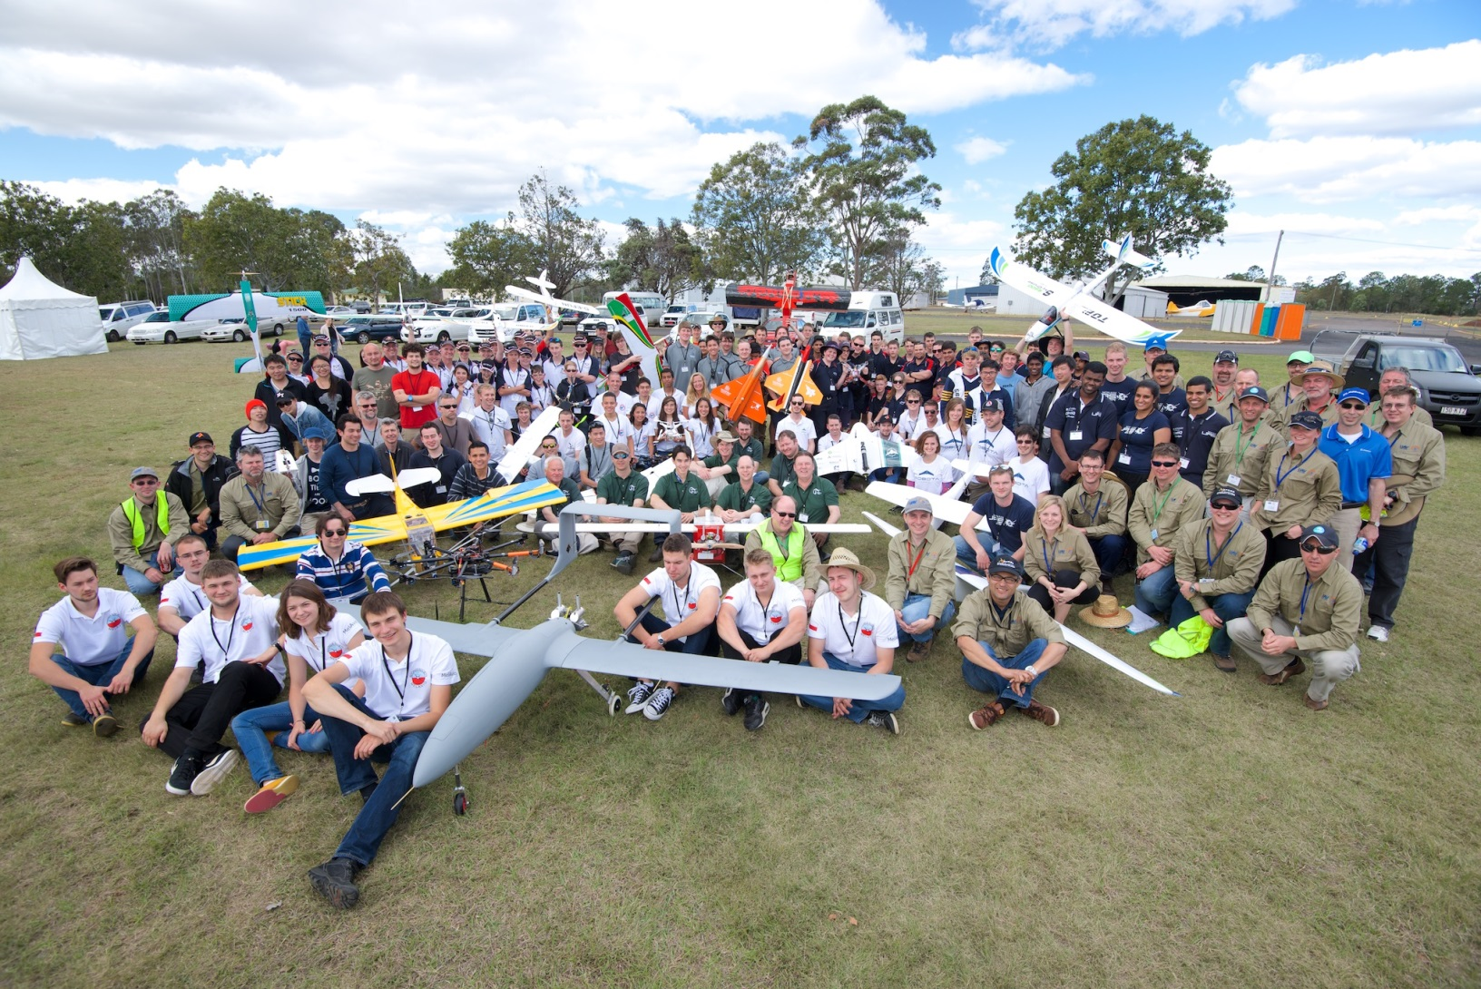
The OBC

Slide 4
The OBC
Objectives
UAV takes off from airport and autonomously travels 5km to search area
UAV covers the 1.5x2.5km search area, looking for the missing bushwalker (Joe)
Must then drop a bottle of water to Joe
Then UAV returns safely to the airport

Slide 5
The OBC
Points are given for
Accuracy of bottle drop
Automatic detection of Joe’s position
Automatic takeoff and landing
Written and oral reports
Emphasis on Safety
All teams must prove that their UAV can be operated in a safe and controlled manner
Failsafe systems must be demonstrated (on the ground)

Slide 6
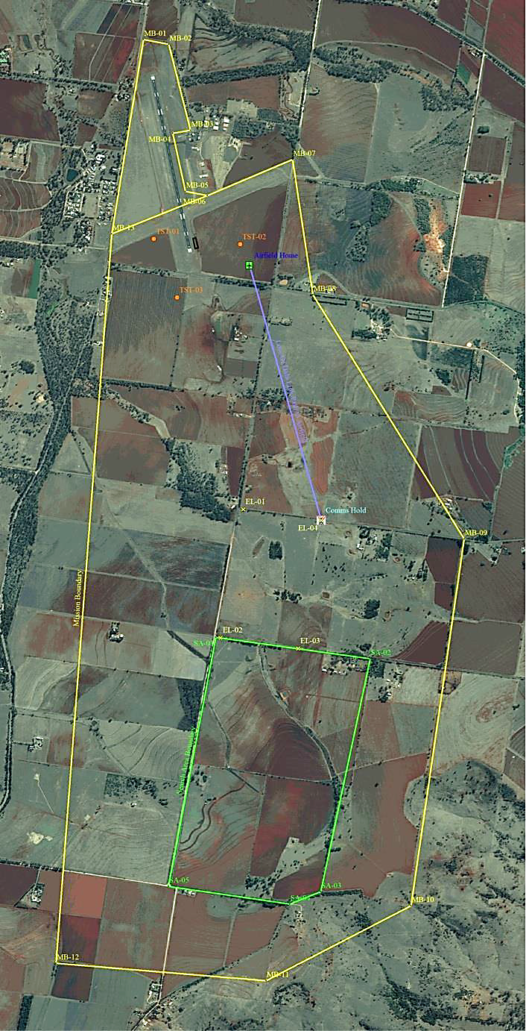
The Search Area
Airport
1km
Competition Boundary
Search Area

Slide 7
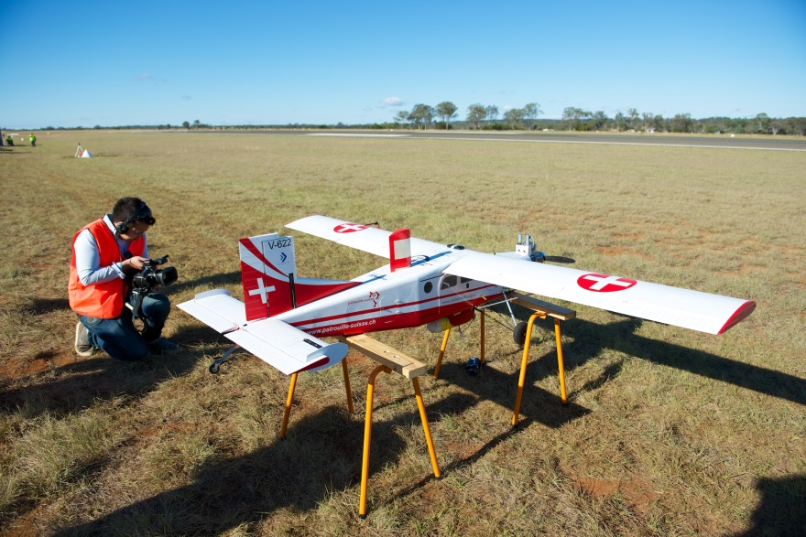
Challenges - Airframe
Need ~60km range
Able to cope with strong winds
Big enough to carry avionics/comms gear
Reliable
Able to be used on short runways

Slide 8
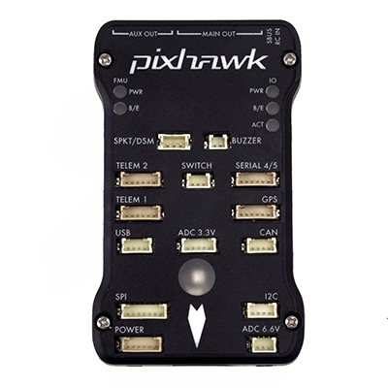
Challenges - Autopilot
Reliability!
Accurate
Able to handle sensor failures or degradation
Easy to debug and test
(Relatively) affordable

Slide 9
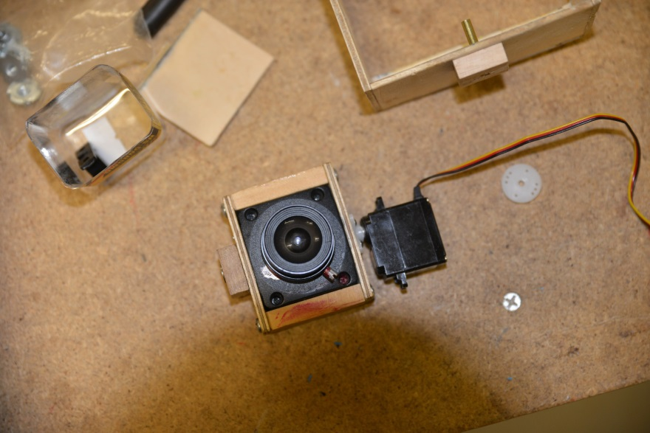
Challenges - Imaging
Ground resolution of 10cm/pixel
Sensitive camera sensor
Fast shutter
CPU power for realtime image processing

Slide 10
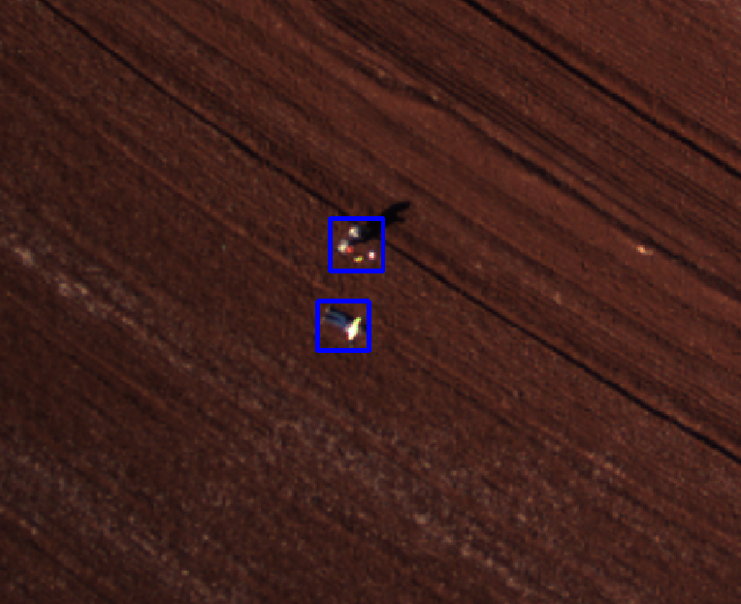
Challenges - Imaging

Slide 11
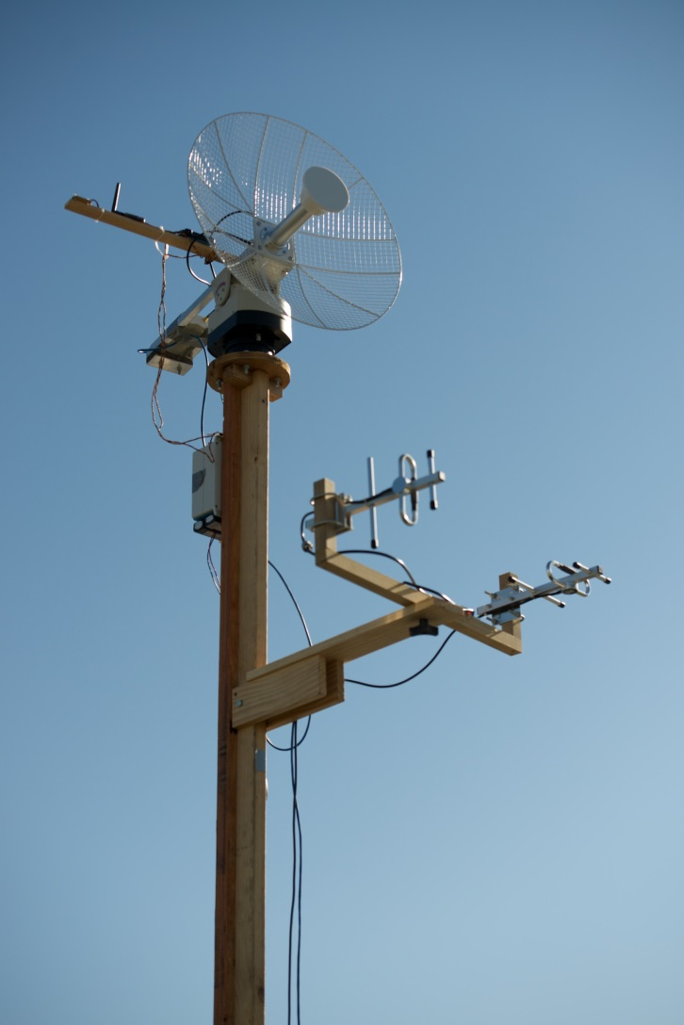
Challenges - Comms
Range of 10km
UAV not able to have stabilised antennas
Reliable link - competition requirement

Slide 12
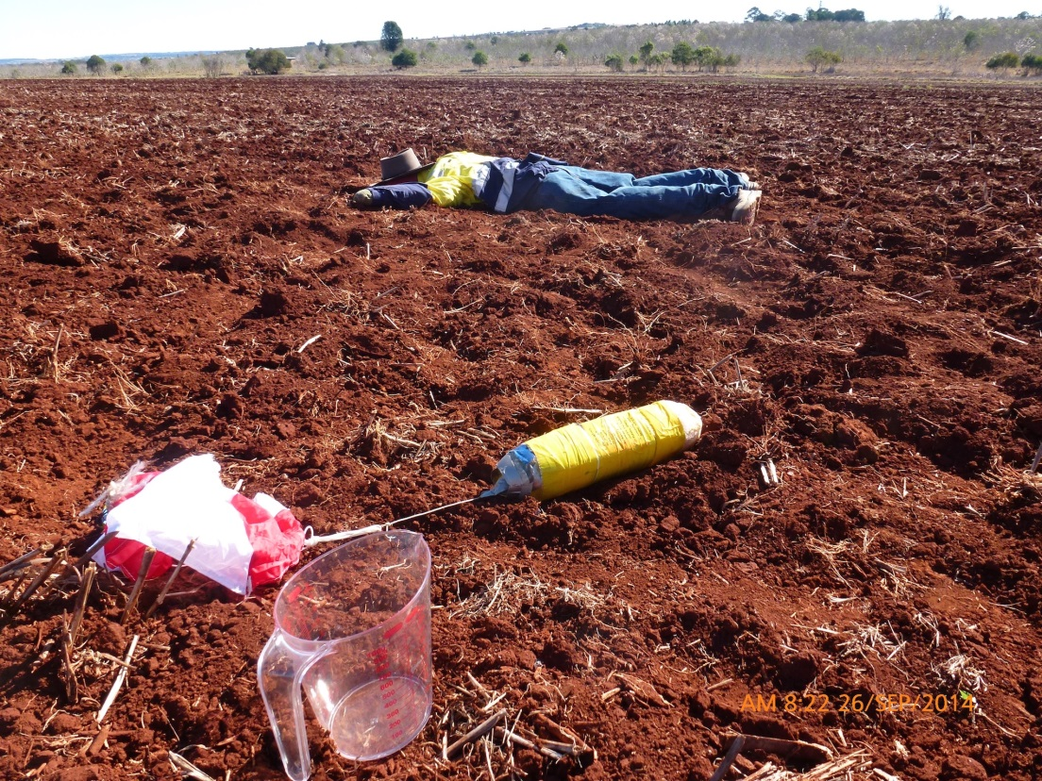
Challenges - Bottle Drop
Wind effects
Padding to protect the bottle
Reliable release mechanism
Predicting the drop location

Slide 13
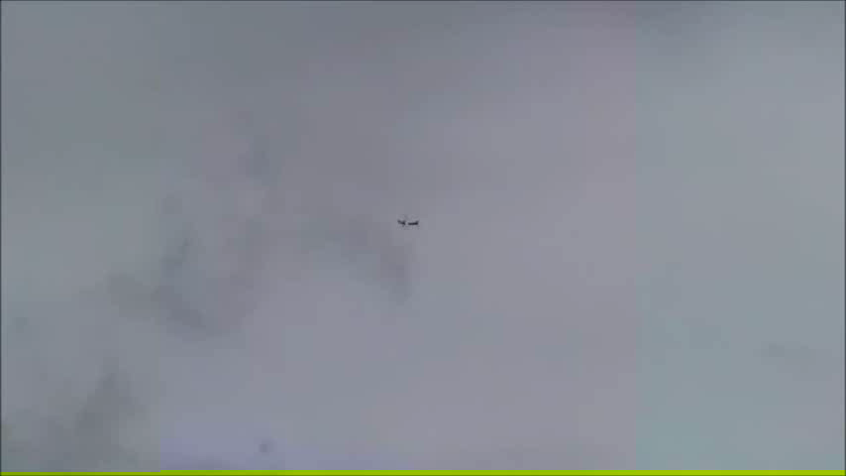
A Bottle Drop Test

Slide 14
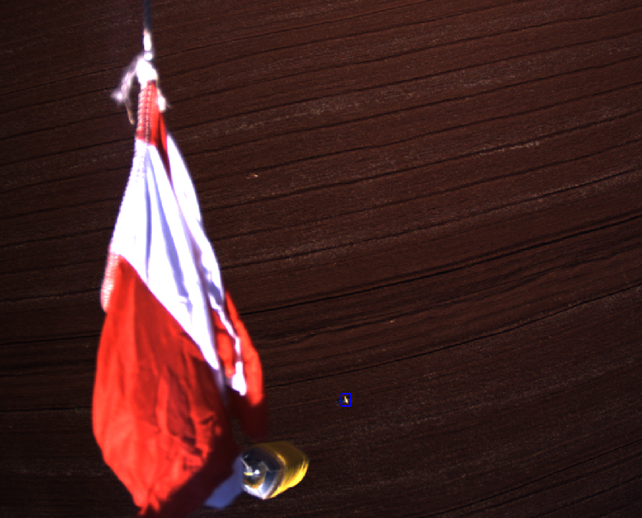
Challenges - Bottle Drop

Slide 15
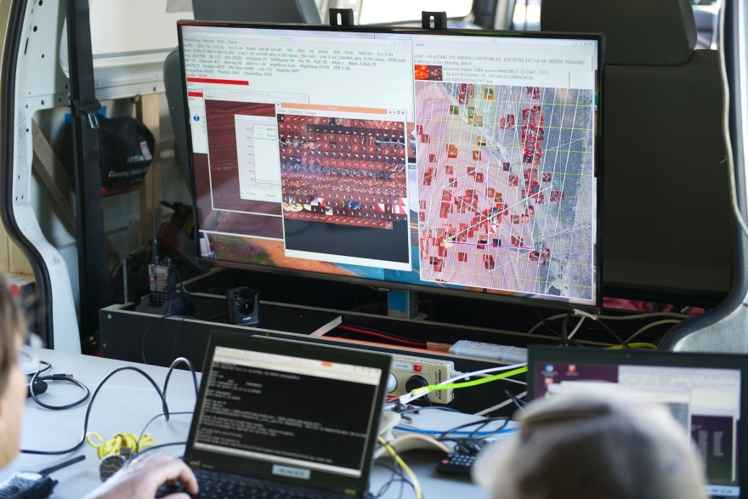
Challenges - Ground Station
Plenty of viewing space for data
Multiple operators
Power and networking

Slide 16
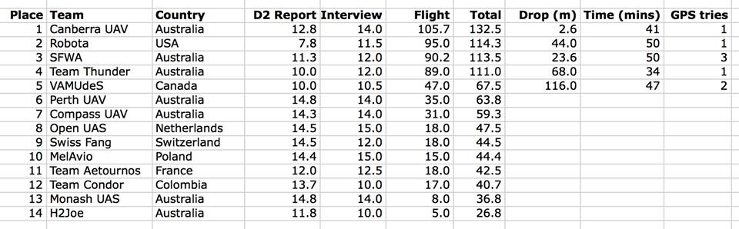
Final Scores

Slide 17
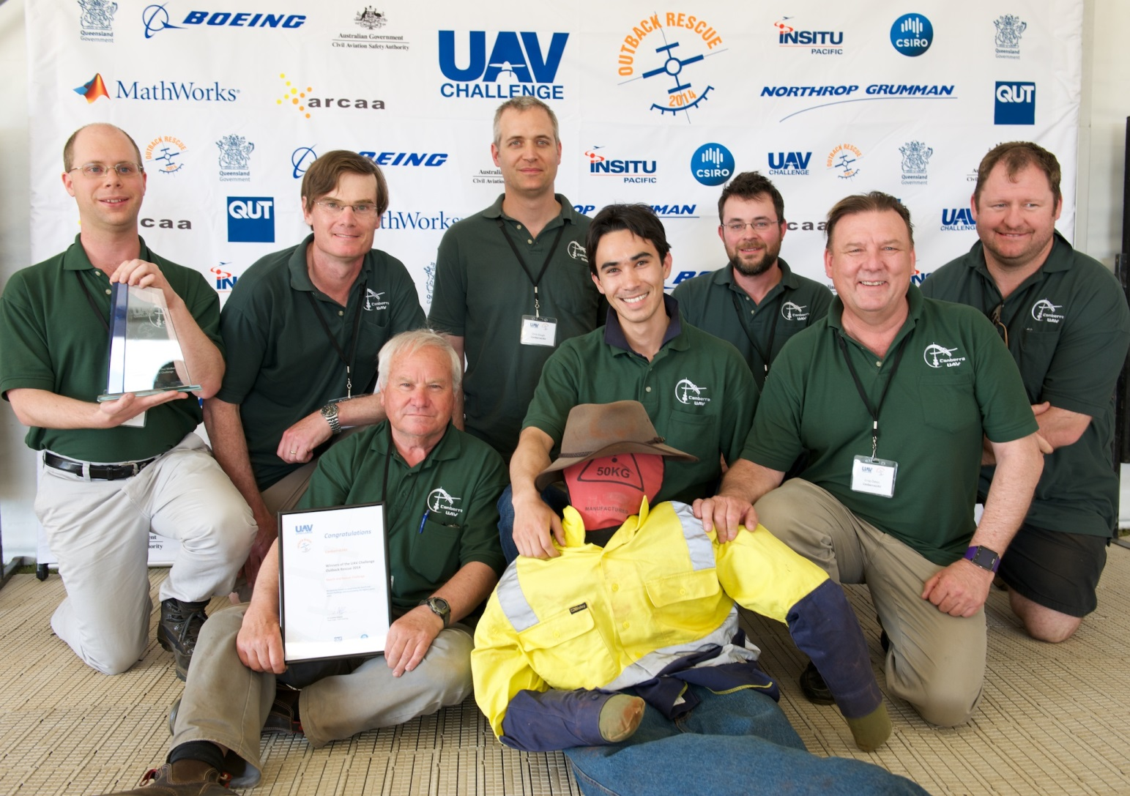
The Winners!

Slide 18
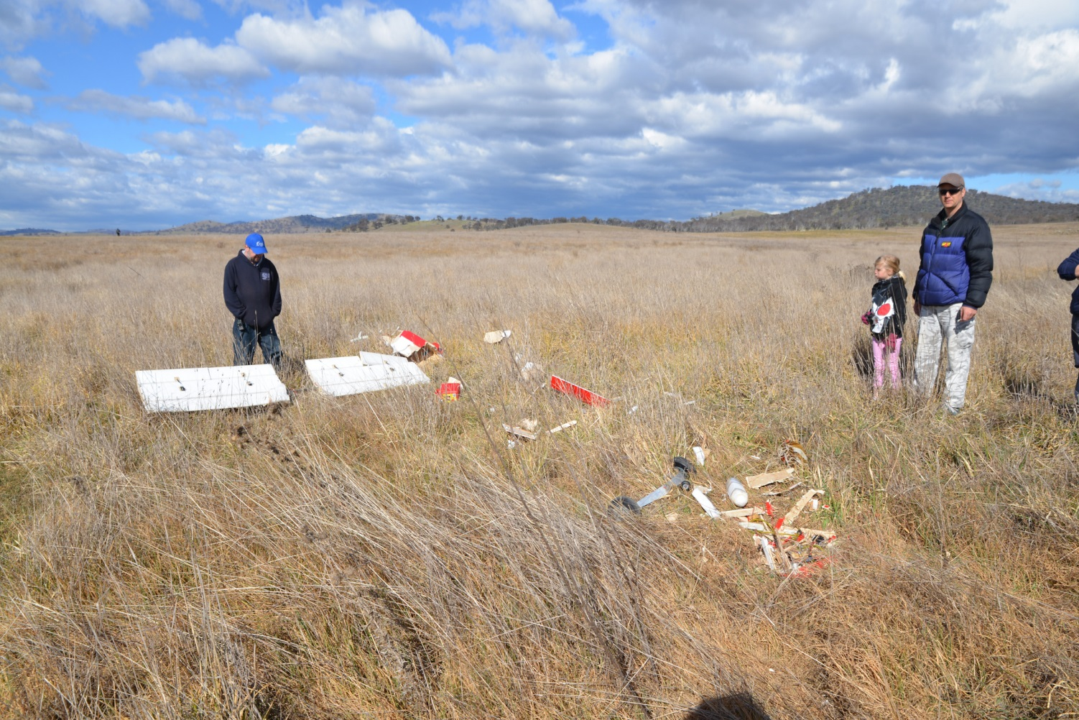
Accidents along the way

Slide 19
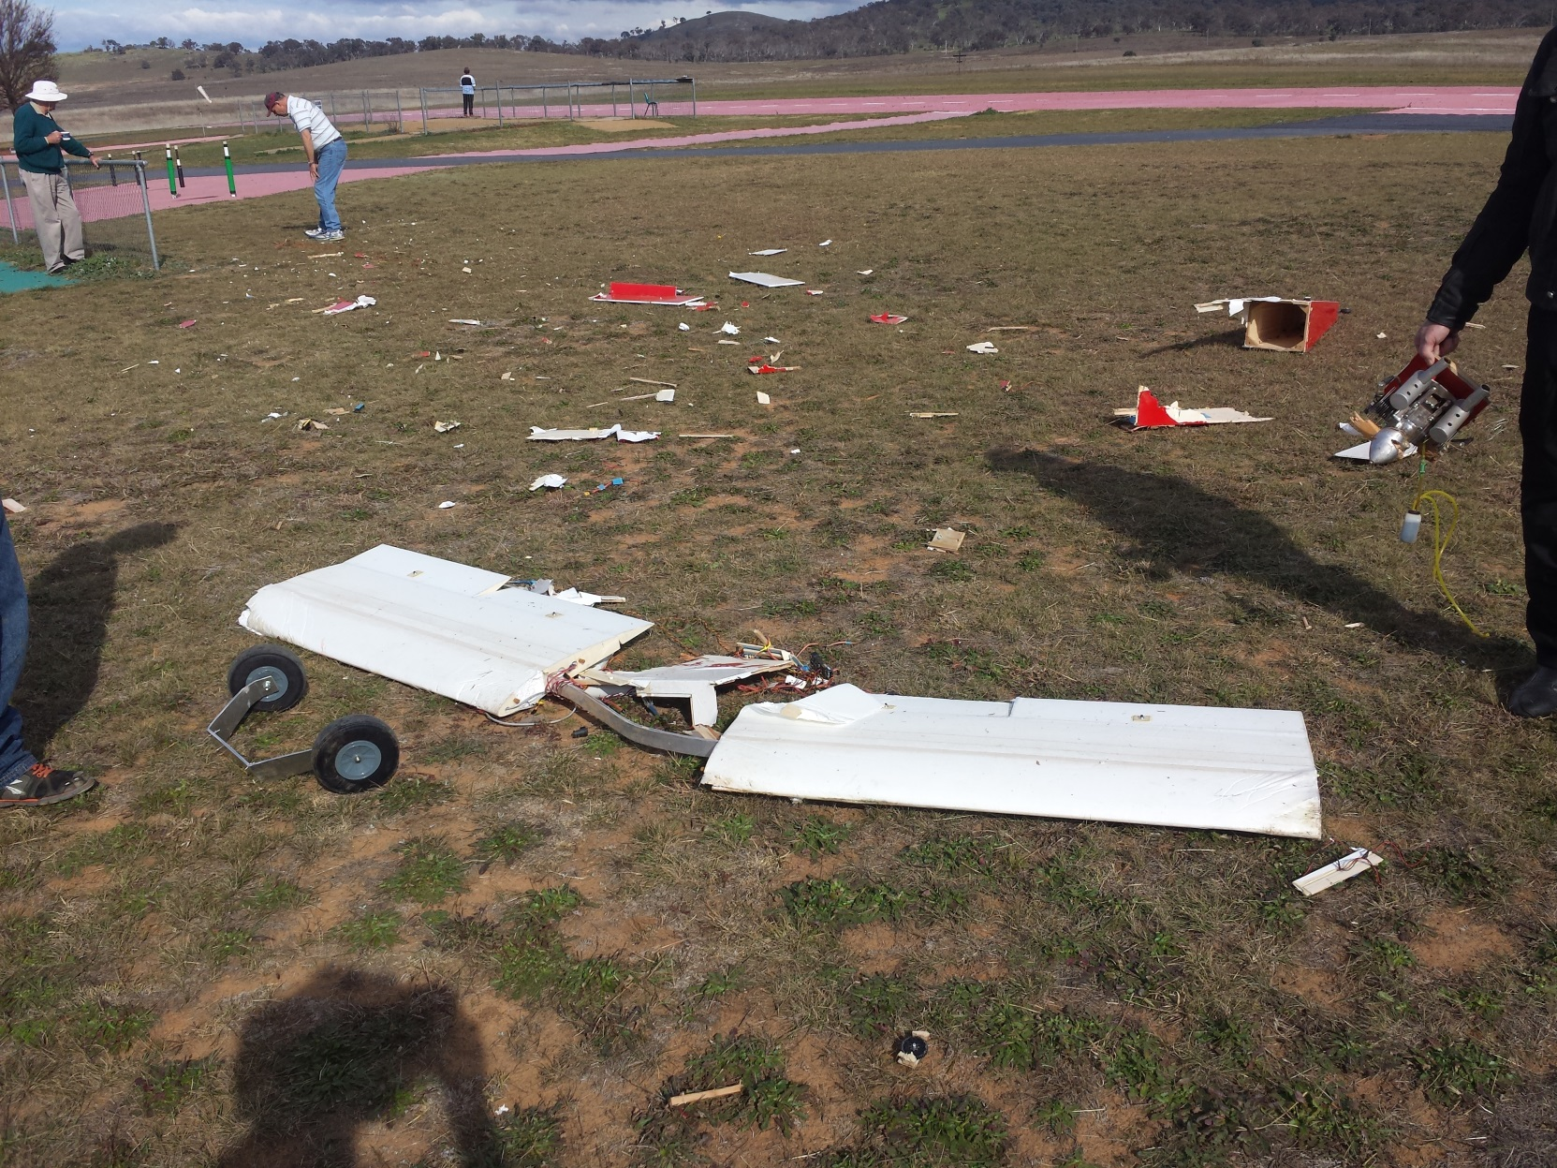
Accidents along the way

Slide 20
Lessons Learnt
Test in all weather conditions
Test all the time!
Simulate in software beforehand
Preflight checklists
Small-scale tests

Slide 21
Where to next
Buy more UAV’s!
Prepare for the next competition (2016)
Collaborate with like-minded organisations
Advance the field of civilian UAV’s

Slide 22
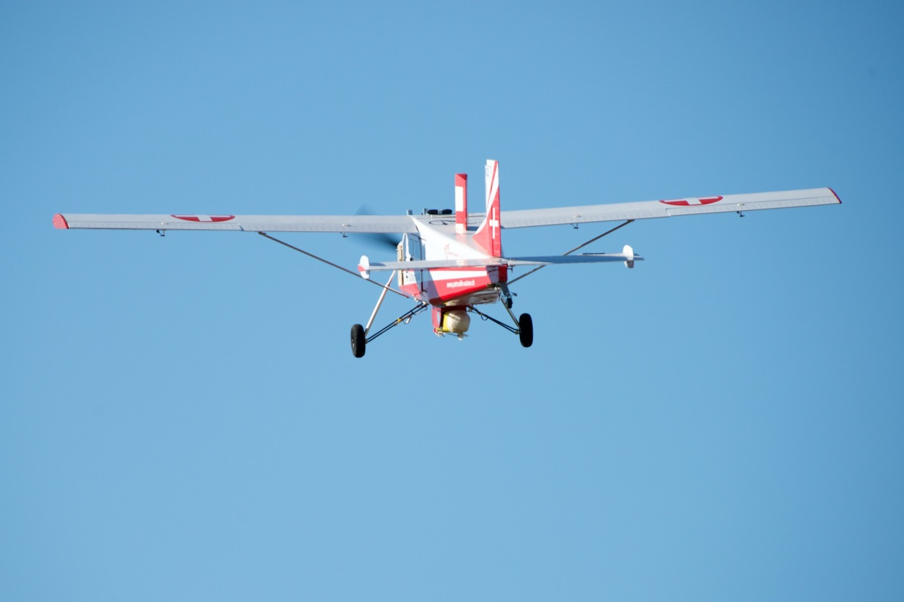
Questions?
www.canberraUAV.org.au

